Slide 1
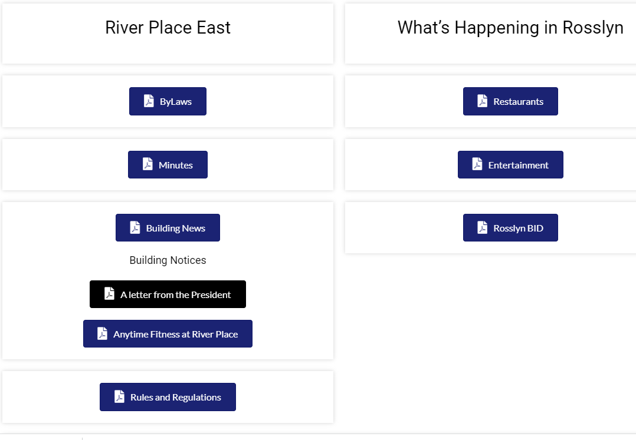
Combine the By-Law and the Minutes under 1 widget called GOVERNANCE;
Then under that widget keep these three buttons: By Laws; Rules & Regulations and Minutes);
The minutes need to be updated by Year, and then by month. The last set is from 2021
Create a widget call “Archives’ and create button underneath that call “Communications”. In the communications, we should file all the past announcements from River Place East to its residents and also this letter from the President.
A second button can also be created called “Photos” and all the pics of our events can also be put there eg Halloween / Christmas Holidays etc.

Slide 2
If the web designer has some interesting ways to showcase our restaurants that would be good.
In the list we can remove the following which have gone out of business:
Starbucks on N. Lynn St
East West Coffee Wine on N. Moore
Bourbon Coffee on N. Lynn
Ben’s Chili Bowl
The Little Beet
And insert:
The Assembly (by Rosslyn metro)
Eclairons 1735 Wilson Blvd.
& Pizza 1800 N. Lynn St
Inca Social 1776 Wilson Blvd
Seoul Spice 1735 N. Lynn St
Guerra Steak 1725 Wilson Blvd
These buttons of entertainment and Rosslyn BID seem to link up to the main again.
I think they can be combined to say: Events Around Rosslyn as one button.
And once that is created we can update with content: eg international women’s day; cinco de mayo celebrations; mother’s day restaurant deals etc.

